Slide 1

SEV-Step
A Single-Stepping Framework for AMD-SEV
Luca Wilke, Jan Wichelmann, Anja Rabich and Thomas Eisenbarth

Slide 2
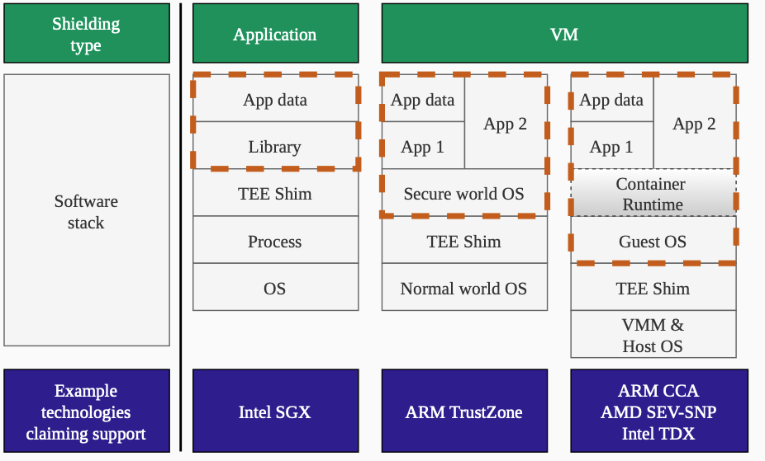
SEV-Step
Single Stepping
Notes:
SEV-Step about AMD SEV
Single Stepping affects all Confidential Computing Solutions

Slide 3
Single-Stepping Attacks
Idea, Exploits, Root Cause

Slide 4



Single-Stepping: Idea
normal
frequently interrupted
single-stepped
CC-BY-SA Nevit Dilmen
Notes:
Instead of attack say: we want to take samples/snapshots of the state of the TEE

Slide 5
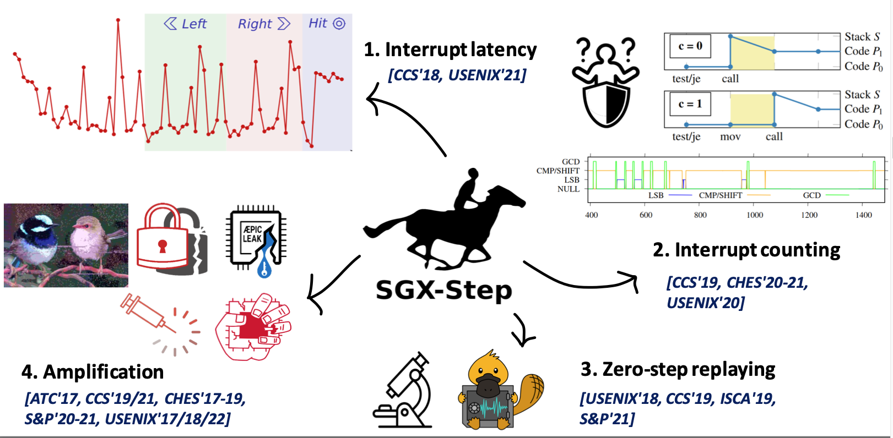

Single-Stepping: Attack Avenues
Inhaltsfolie mit 2 Spalten und Unterüberschriften
SGX-Step
CC-BY Jo van Bulck
Notes:
SGX Step Usage
Interupt Latency
Attack programs with secret dependent control flow. Count instructions to reveal secret
No Architectural progress but microarchitectural effects
As ampliflier for a wide range of mescalaneos attacks (mds attacks like lvi, zombieload)

Slide 6
Can SEV VMs be single-stepped?
Notes:
Highlight here, that this has not been done before

Slide 7

Single-Stepping: Mechanism
Inhaltsfolie mit 2 Spalten und Unterüberschriften
Host / Hypervisor
Setup
VM
VMRUN
Instr 1
When do we exit?
Intercepted Instruction
Page Fault
External Interrupt
Instr 2
Handle exit
Instr 3

Slide 8

Single-Stepping: Mechanism
Inhaltsfolie mit 2 Spalten und Unterüberschriften
Host / Hypervisor
APIC Timer Interrupt
Setup
VM
VMRUN
Instr 1
Instr 2
Handle exit
Instr 3

Slide 9
Single-Stepping: Root Cause
Inhaltsfolie mit 2 Spalten und Unterüberschriften
Setup Timer
VMRUN
Instr 1
Instr 2
Instr 3

Slide 10
Single-Stepping: Root Cause
Inhaltsfolie mit 2 Spalten und Unterüberschriften
What happens now?
Setup Timer
VMRUN
Instr 1
Instr 2
Instr 3

Slide 11
Single-Stepping: Naive Implementation
Inhaltsfolie mit 2 Spalten und Unterüberschriften
Zero Step
Single Step
Multi Step
Setup Timer
VMRUN
Instr 1
Instr 2
Instr 3
Notes:
These are the results when naively implementing on SEV

Slide 12
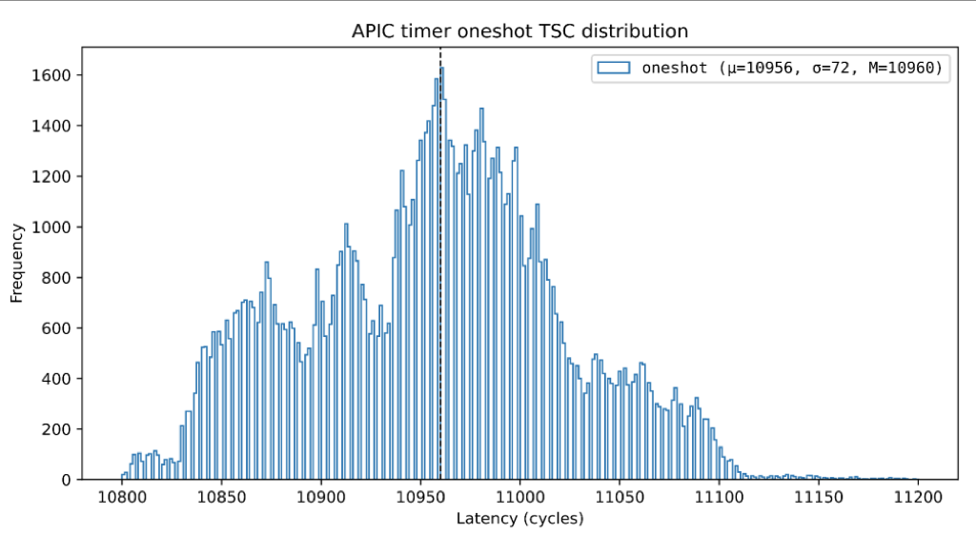
Single-Stepping: APIC Timing on SGX
Inhaltsfolie mit 2 Spalten und Unterüberschriften
Measurements from
AEX-Notify paper
Setup Timer
VMRUN
Instr 1
Instr 2
Instr 3
Zero Step
Single Step
Multi Step
Notes:
This Data is from AEX Notify Paper and shows the timer distribution there. Looking at his data our results make sense.
What do we do to fix it?

Slide 13
Single-Stepping: Enlarge the Window
Inhaltsfolie mit 2 Spalten und Unterüberschriften
Flush Instr 1
Setup Timer
VMRUN
Instr 1
Instr 2
Instr 3
Fetch -> Decode –> Issue ->Retire
Requires Instruction Page
Notes:
FLUSH

Slide 14
Single-Stepping: Enlarge the Window
Inhaltsfolie mit 2 Spalten und Unterüberschriften
Flush Instr 1
Setup Timer
VMRUN
Instr 1
Instr 2
Instr 3
Fetch -> Decode –> Issue ->Retire
Slow
Notes:
Now it works
SEV Step is the first to reliably single step sev

Slide 15
SEV-Step
Titelfolie
Design Goals, Implementation, Ongoing work

Slide 16
SEV-Step: Design Goals
Inhaltsfolie mit 2 Spalten und Unterüberschriften
Reusability
Separate primitives from attack logic
Interactivity
Bidirectional Communication

Slide 17
SEV-Step: Reusability
Inhaltsfolie mit 2 Spalten und Unterüberschriften
Linux / KVM
(Hypervisor)
Setup
Implement everything here?
VM
VMRUN
Instr 1
Instr 2
Handle exit
Instr 3
Notes:
Kernel Development is hard
- limited programming environment
- frequent crashes

Slide 18
SEV-Step: Reusability
Inhaltsfolie mit 2 Spalten und Unterüberschriften
Data Flow
Control Flow
SEV-Step Library
Linux / KVM
(Hypervisor)
Rich API /
Complex Attack Logic
Setup
VM
IOCTL API
VMRUN
Instr 1
Instr 2
Handle exit
Instr 3
Host User Space
Host Kernel Space
VM

Slide 19
SEV-Step: Design Goals
Inhaltsfolie mit 2 Spalten und Unterüberschriften
Reusability ✅
Separate primitives from attack logic
Interactivity
Bidirectional Communication

Slide 20
SEV-Step: Interactivity?
Inhaltsfolie mit 2 Spalten und Unterüberschriften
Data Flow
Control Flow
SEV-Step Library
Linux / KVM
(Hypervisor)
Rich API /
Complex Attack Logic
Setup
IOCTL API
VM
VMRUN
Instr 1
Instr 2
Handle exit
Instr 3
Host User Space
Host Kernel Space
VM

Slide 21



SEV-Step: Interactivity
Inhaltsfolie mit 2 Spalten und Unterüberschriften
Data Flow
SEV-Step Library
Linux / KVM
(Hypervisor)
Control Flow
Initialize Config
Setup
Wait for Event
IOCTL API
VMRUN
Process Event
VM
Handle exit
Instr 1
( Adapt Config )
Event?
Instr 2
Ack Event
Send & Wait
Instr 3
Host User Space
Host Kernel Space
VM

Slide 22
SEV-Step: Interactivity
Inhaltsfolie mit 2 Spalten und Unterüberschriften
Data Flow
SEV-Step Library
Linux / KVM
(Hypervisor)
Control Flow
Initialize Config
Setup
Wait for Event
IOCTL API
VMRUN
Process Event
Shared Memory
VM
Handle exit
Instr 1
( Adapt Config )
Event?
Instr 2
Ack Event
Send & Wait
Instr 3
Host User Space
Host Kernel Space
VM

Slide 23
SEV-Step: Design Goals
Inhaltsfolie mit 2 Spalten und Unterüberschriften
Reusability ✅
Separate primitives from attack logic
Interactivity ✅
Bidirectional Communication

Slide 24
SEV-Step: Ongoing Work
Inhaltsfolie mit 2 Spalten und Unterüberschriften
Improve API
  Current Design: Track/Untrack, Start Stepping/Stop Stepping
  Goal: High Level Components: „Track Pagefault Sequence“
  Model SEV-Step + SGX-Step as „drivers“

Slide 25
Summary
Inhaltsfolie mit 2 Spalten und Unterüberschriften
Single-Stepping enables many attacks
Popularized for SGX with SGX-Step
SEV-Step Framework
  First to show that SEV is vulnerable to single-stepping
  Ease attack research on SEV
  GPL V2
Ongoing work
  Improve attack prototyping
Play with it, break it, Improve it
SEV-Step
SGX-Step

