Slide 1
Single-Stepping Attacks and Defences for Confidential VMs
Luca Wilke Institute for IT-Security
University of Lübeck

Slide 2
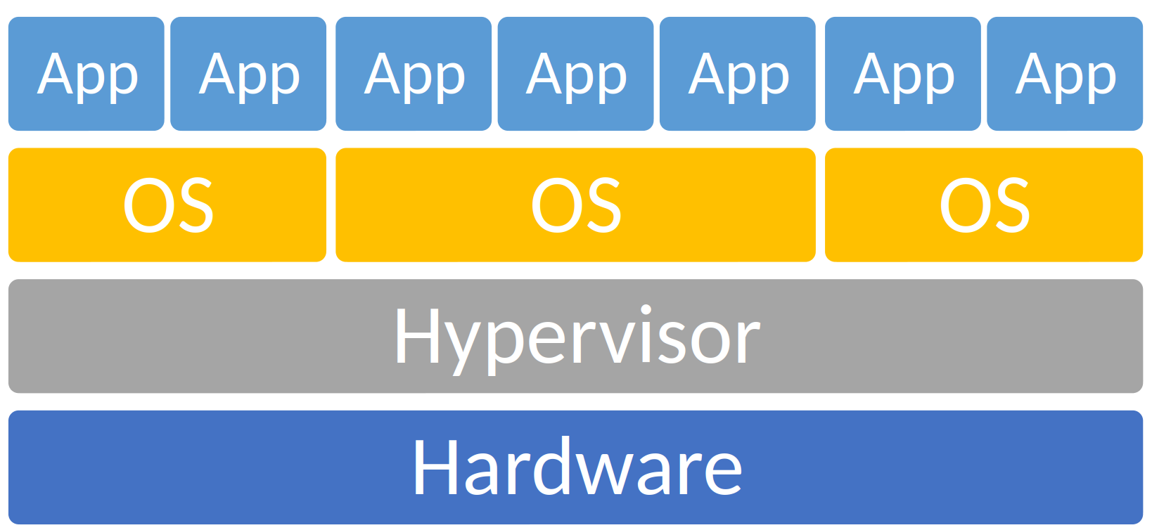
Trusted Execution Environments
Use Cases
Cloud computing ➡ remove hypervisor from TCB
Complex software stacks ➡ isolated compartments
Attack
Attack
Attack

Slide 3
Single-Stepping Attacks
Idea, Attacks on SGX, Attacks on SEV

Slide 4
Single-Stepping: Idea
normal
frequently interrupted
single-stepped
CC-BY Jo van Bulck
CC-BY-SA Nevit Dilmen

Slide 5
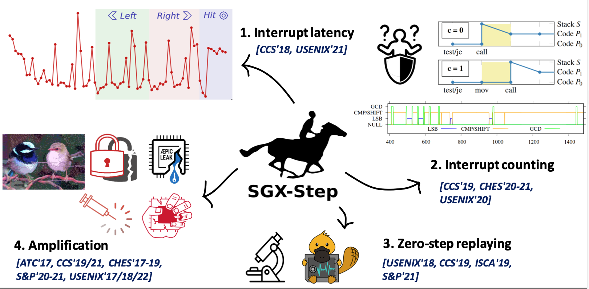
Single-Stepping: Attack Avenues
Inhaltsfolie mit 2 Spalten und Unterüberschriften
SGX-Step
CC-BY Jo van Bulck

Slide 6
Can SEV-SNP be Single-Stepped?

Slide 7
Single-Stepping: Mechanism
Inhaltsfolie mit 2 Spalten und Unterüberschriften
Host / Hypervisor
Setup
VM
VMRUN
Instr 1
When do we exit?
Intercepted Instruction
Page Fault
External Interrupt
Instr 2
Handle exit
Instr 3

Slide 8
Single-Stepping: Mechanism
Inhaltsfolie mit 2 Spalten und Unterüberschriften
Host / Hypervisor
APIC Timer interrupt
Setup
VM
VMRUN
Instr 1
Instr 2
Handle exit
Instr 3

Slide 9
Single-Stepping: Root Cause
Inhaltsfolie mit 2 Spalten und Unterüberschriften
Setup Timer
VMRUN
Instr 1
Instr 2
Instr 3

Slide 10
Single-Stepping: Naive Implementation
Inhaltsfolie mit 2 Spalten und Unterüberschriften
Zero Step
Single Step
Multi Step
Setup Timer
VMRUN
Instr 1
Instr 2
Instr 3

Slide 11
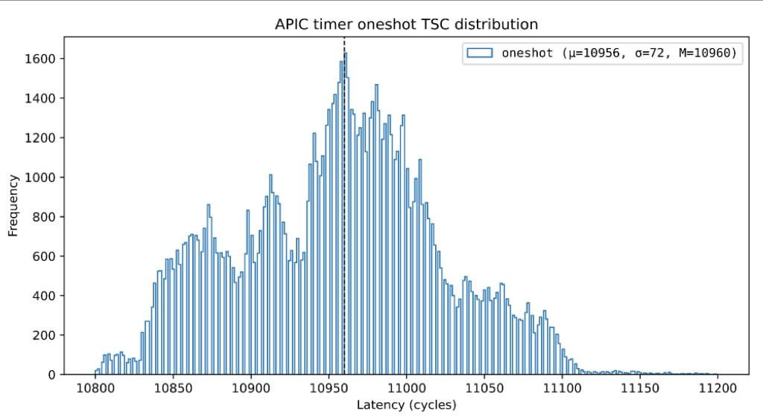
Single-Stepping: APIC Timing on SGX
Inhaltsfolie mit 2 Spalten und Unterüberschriften
Measurements from
AEX-Notify paper
Setup Timer
VMRUN
Instr 1
Instr 2
Instr 3
Zero Step
Single Step
Multi Step
Notes:
This Data is from AEX Notify Paper and shows the timer distribution there. Looking at his data our results make sense.
What do we do to fix it?

Slide 12
Single-Stepping: Enlarge the Window
Inhaltsfolie mit 2 Spalten und Unterüberschriften
Flush Instr 1
Setup Timer
VMRUN
Instr 1
Instr 2
Instr 3
Fetch -> Decode –> Issue ->Retire
Requires Instruction Page
Notes:
FLUSH

Slide 13
Single-Stepping: Enlarge the Window
Inhaltsfolie mit 2 Spalten und Unterüberschriften
Flush Instr 1
Setup Timer
VMRUN
Instr 1
Instr 2
Instr 3
Fetch -> Decode –> Issue ->Retire
Slow
Notes:
Now it works
SEV Step is the first to reliably single step sev

Slide 14
SEV-Step
Titelfolie
SEV-Step
A Single-Stepping Framework for AMD-SEV, CHES 2024
Luca Wilke, Jan Wichelmann, Anja Rabich and Thomas Eisenbarth

Slide 15
SEV-Step Overview
Inhaltsfolie mit 2 Spalten und Unterüberschriften
Data Flow
Control Flow
SEV-Step Library
Linux / KVM
(Hypervisor)
Rich API / Complex Attack Logic
Setup
IOCTL API
VM
VMRUN
Instr 1
Instr 2
Handle exit
Instr 3
Host User Space
Host Kernel Space
VM

Slide 16
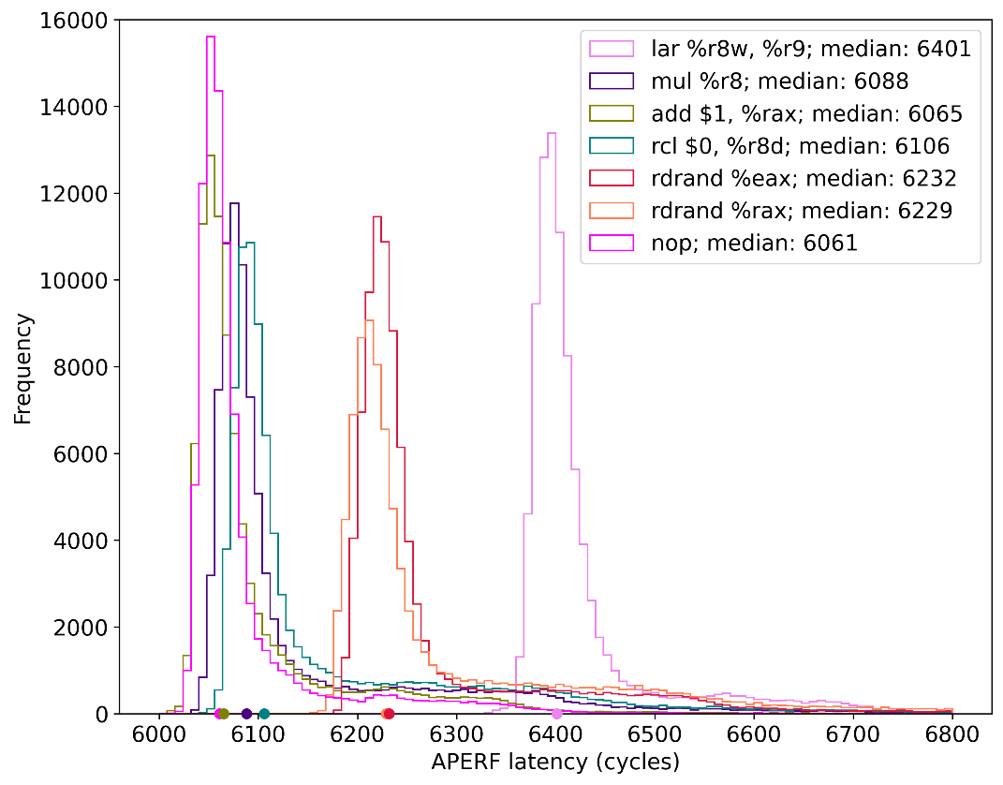
SEV-Step: Attacks
Inhaltsfolie mit 2 Spalten und Unterüberschriften
Interrupt Latency
Cache Attacks
(only used progress detection from SEV-Step)

Slide 17
Countermeasures
Titelfolie
Detection+Throttling, Prefetching, Application Rewriting

Slide 18
TDX: Detection + Throttling

Slide 19
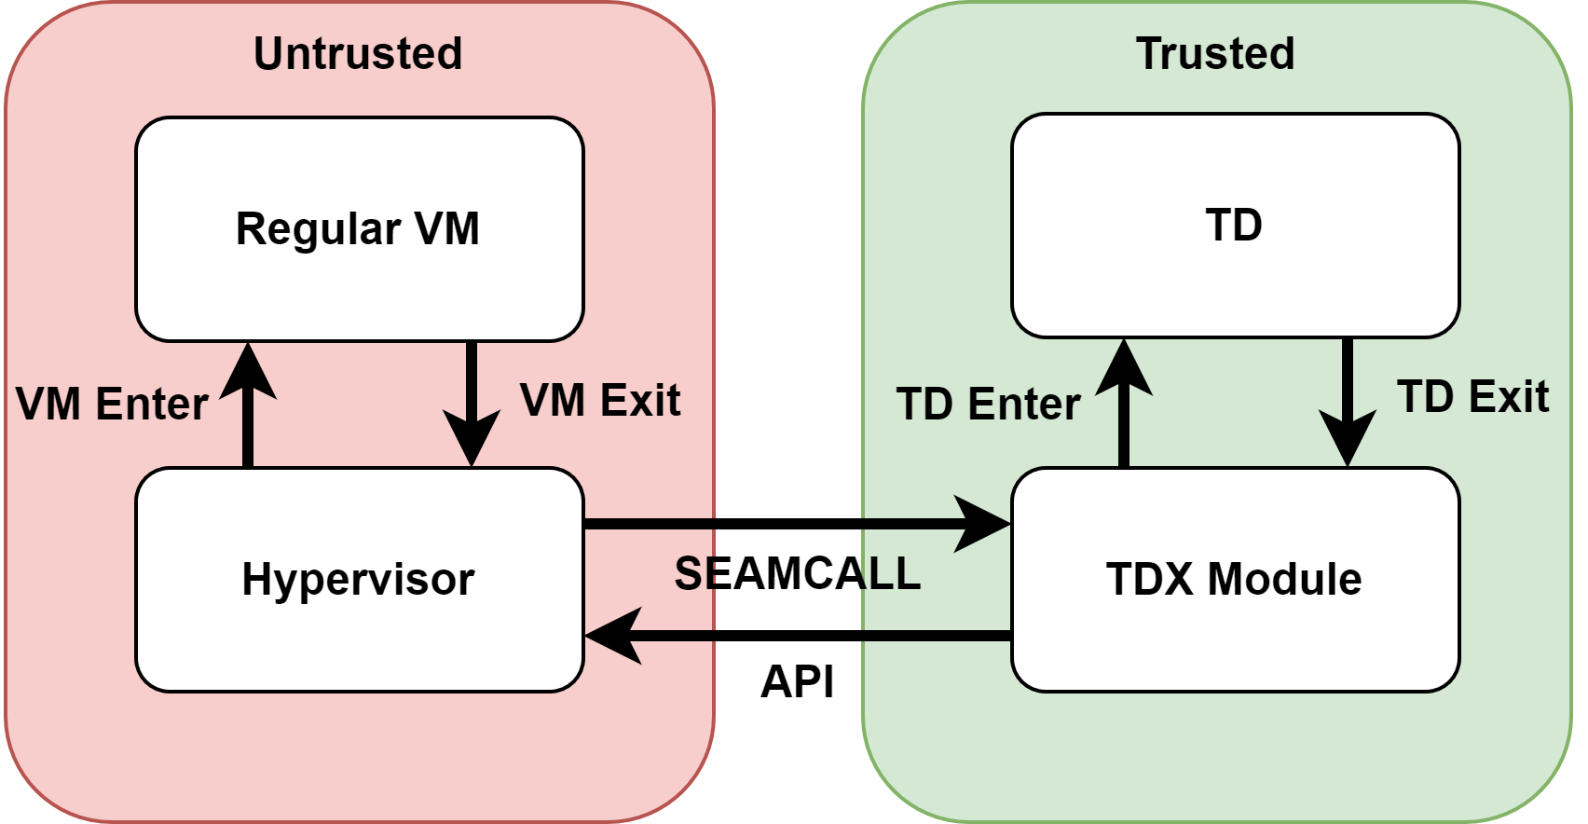
TDX: Architecture
Inhaltsfolie mit 2 Spalten und Unterüberschriften

Slide 20
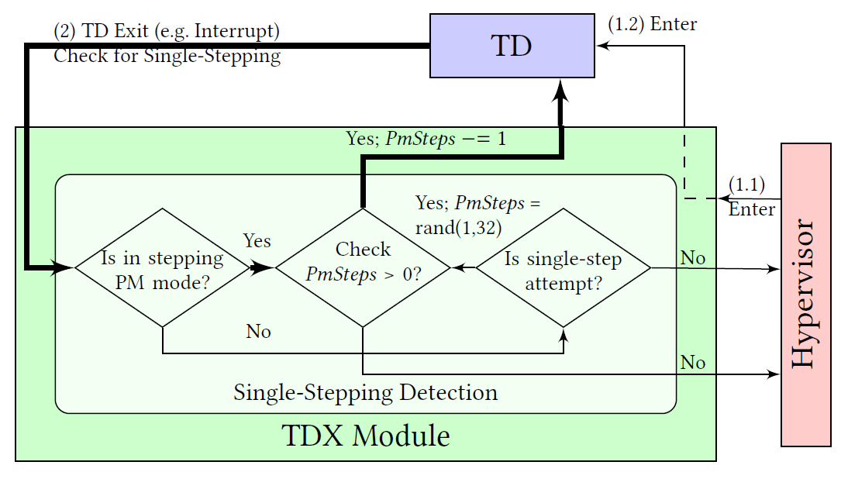
TDX: Single-Stepping Countermeasure
Inhaltsfolie mit 2 Spalten und Unterüberschriften
„At least 2 Instructions Executed“ OR „Low Interrupt Rate“
Notes:
Obtained from the source code fo the publicly available TDX module code

Slide 21
SGX: AEX-Notify
AEX-Notify, 32nd USENIX Security, S. Constable, J. Van Bulck, X. Cheng, Y. Xiao, C. Xing, I. Alexandrovich, T. Kim, F. Piessens, M. Vij, M. Silberstein.

Slide 22
Recap Single-Stepping
Inhaltsfolie mit 2 Spalten und Unterüberschriften
Flush Instr 1
Setup Timer
Enter SGX
Instr 1
Instr 2
Instr 3
Fetch -> Decode –> Issue ->Retire
Slow
Notes:
Now it works
SEV Step is the first to reliably single step sev

Slide 23
AEX-Notify: Undo Slowdown
Inhaltsfolie mit 2 Spalten und Unterüberschriften
Flush Instr 1
Setup Timer
Enter SGX
Countermeasure
Instr 1
Instr 2
Instr 3
Undo artificial slowdown by Prefetching Code + Data for Instr. 1
Too fast for reliable single-stepping
Notes:
FLUSH

Slide 24
SEV-SNP and ARM CCA

Slide 25
Applying AEX-Notify to CVMs

Slide 26
CVM Requirements for AEX-Notify
Make VM ext. Intr. aware
Deploy Countermeasure in VM

Slide 27
Make VM ext. Interrupt Aware
Host / Hypervisor
APIC Timer Interrupt
Setup
VM
VMRUN
Instr 1
Instr 2
Handle exit
Instr 3
HW makes exit transparent for VM

Slide 28
Make VM ext. Interrupt Aware
Hey you have been interrupted
Host / Hypervisor
Idea:
Reuse existing interrupt injection mechanisms
APIC Timer Interrupt
Setup
VM
VMRUN
Instr 1
Instr 2
Handle exit
Instr 3
HW makes exit transparent for VM

Slide 29
What About Benign Injections?
Host / Hypervisor
Setup
VM
Injected Interrupt
Current Execution State
VMRUN
Interrupt Handlers
“Victim” Code
Handle exit

Slide 30
Generic Application Level Countermeaures
Notes:
What else can we do to prevent side channel attacks like single stepping, if we cannot change the TEE?
Constant Time helps but is tedious to program by hand for whole applications.
Ciphertext side channels still remain
Need generic transformation for our program

Slide 31
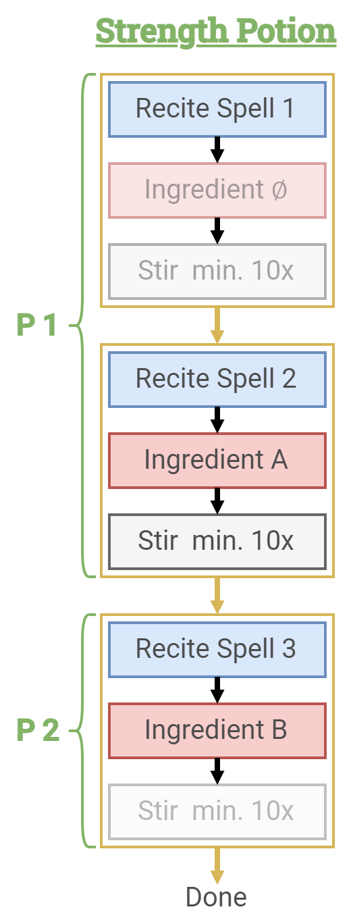
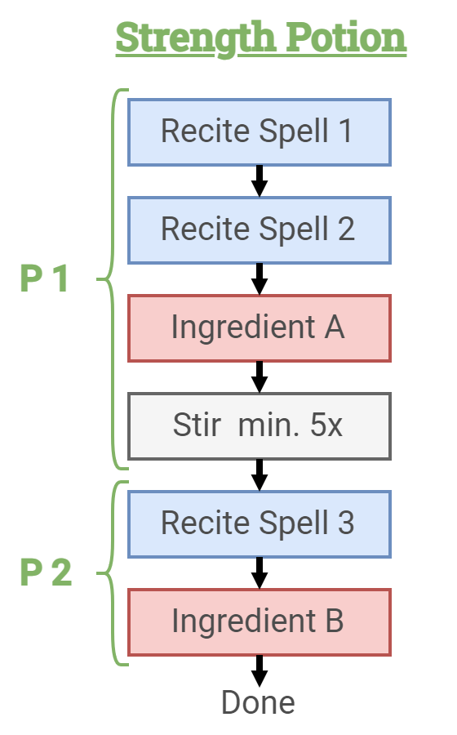
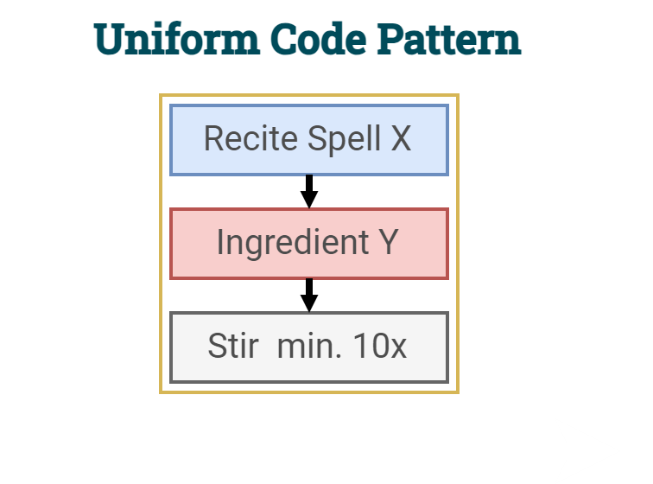
OBELIX: Generic App Level Countermeasure
OBELIX, S&P 2024, J. Wichelmann, A. Rabich, A. Pätschke, T. Eisenbarth

Slide 32
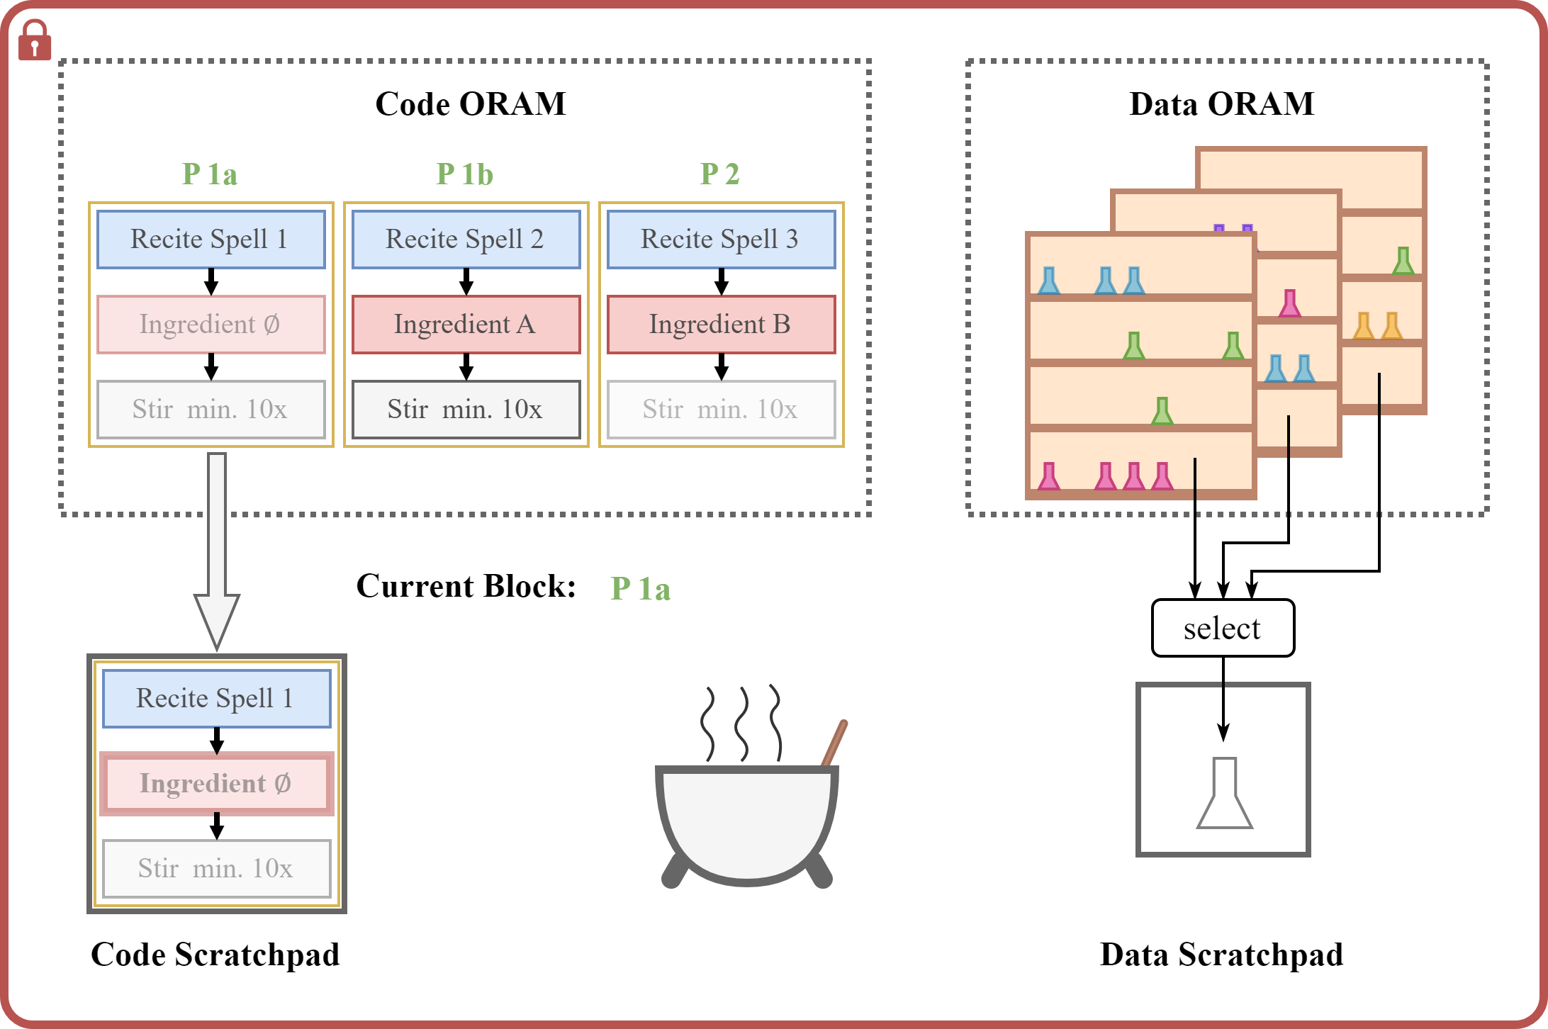
OBELIX: Generic App Level Countermeasure
Notes:
Overhaeds up to factor 100k for big programs
Small snippets factor

Slide 33
OBELIX: Generic App Level Countermeasure
Pro
Con
Generic
Eliminates
Cache attacks
Single-Stepping
Ciphertext-Side channels
Instruction latency attacks
...
High overhead
Notes:
from factor 200 up to factor 100k

Slide 34
Summary

Slide 35
Summary
CVMs are vulnerable to single-stepping
SEV-SNP an ARM CCA do not have mitigations
TDX has mitigation, but hard to transfer to other CVMs
AEX-Notify could be applicable to CVMs ➡ generic mitigation?
App level countermeasures: high protection, high overhead

